Slide 1

Liberal fatalism, Covid 19 and the politics of impossibility
Dr Jana Bacevic
Durham University
Conférence: De la démobilisation publique au Covidactivisme
Association Winslow Santé Publique
26 September 2024

Slide 2
Link knowledge ⬅➔ action
Liberal modernity: rational planning, the ability to predict key to constitution of modern societies and their political legitimacy
If we know / can predict threats, we can act to prevent, mitigate, or protect the public from them
Knowledge = prediction
Prediction → prevention
→ mitigation
=> protection

Slide 3


Link knowledge ⬅➔ action
Liberal modernity: rational planning, the ability to predict
If we know / can predict threats, we can act to prevent, mitigate, or protect the public from them
Knowledge ≠ prediction
Prediction → prevention
→ mitigation
=> protection
Examples: pandemics, climate change, environmental risks, pollution, terrorism

Slide 4
The ‘puzzle’ of the UK’s Covid-19 strategy
Late, reluctant, and inconsistent introduction of non-pharmaceutical interventions (NPIs) to limit spread and protect population (bans on gatherings, closures of schools and workplaces, general ‘lockdown’)
(2) Confused and inconsistent messaging (‘control the virus’?)
(3) Delayed development of test and trace capacity
(4) High economic, social, and health cost

Slide 5
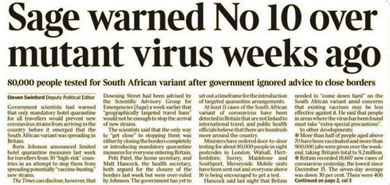
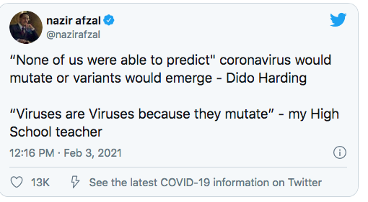
Surprise! Viruses mutate

Slide 6
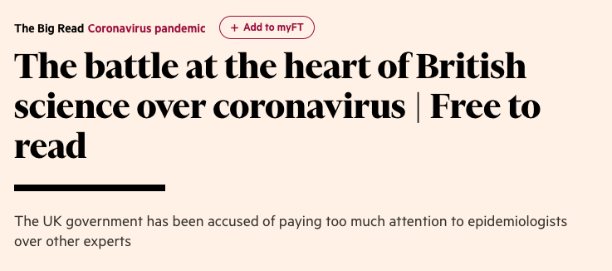
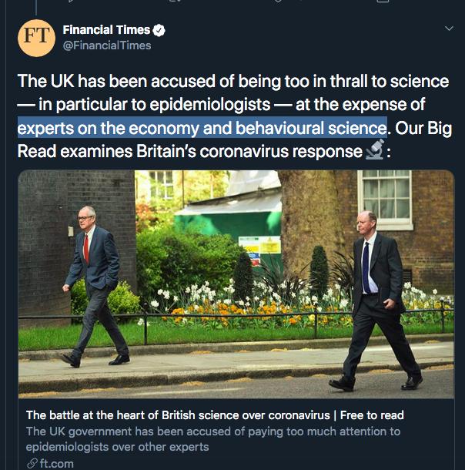
Explanations
Politics?
Incompetence
Ideological commitment to Brexit => failures in EU-driven PPE procurement
Experience of H1N1 (spending on the ‘pandemic that never came’)
Epistemology?
The nature of virus (unknown)
Too much science (of the wrong kind)
Too little science (populism, ‘post-truth’)
Notes:
We don’t really have to have this slide, but thought it would be useful to contrast ‘political’ and ‘epistemic’ explanations, to justify our focus on political epistemology; we could integrate it into the preceding onne

Slide 7
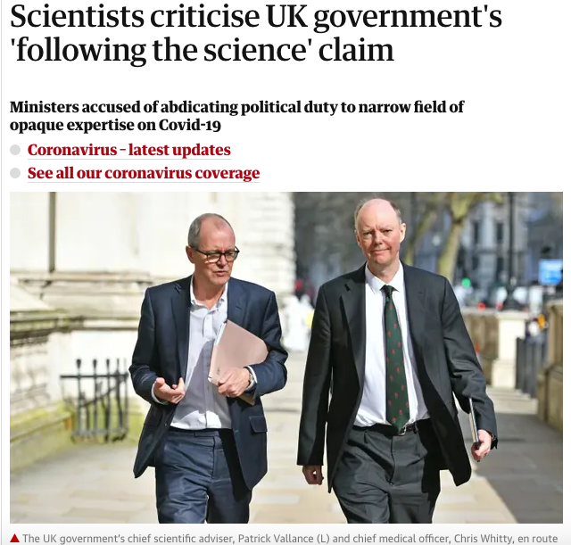
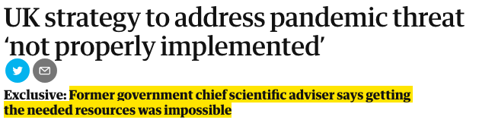
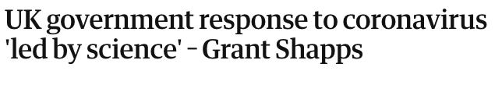
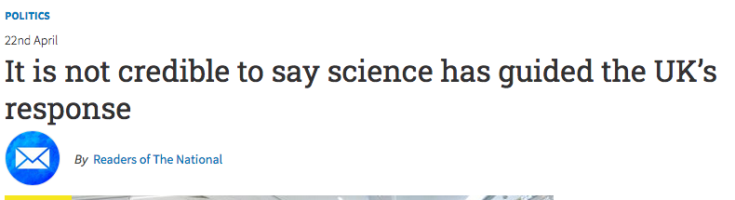
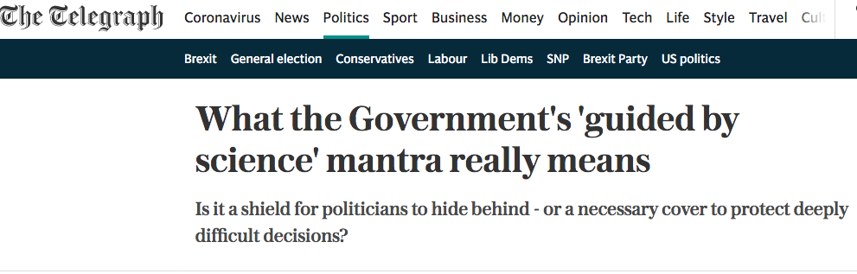
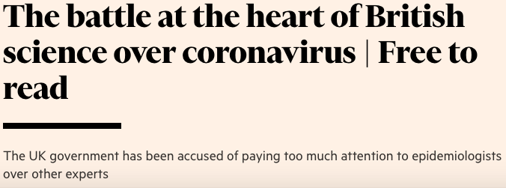
Science
Notes:
'Science’ figured prominently in UK Government’s response to the Coronavirus pandemic
‘Guided by the science’; ‘Best science available’; ‘Scientific advice’
How does this relate to knowledge?

Slide 8
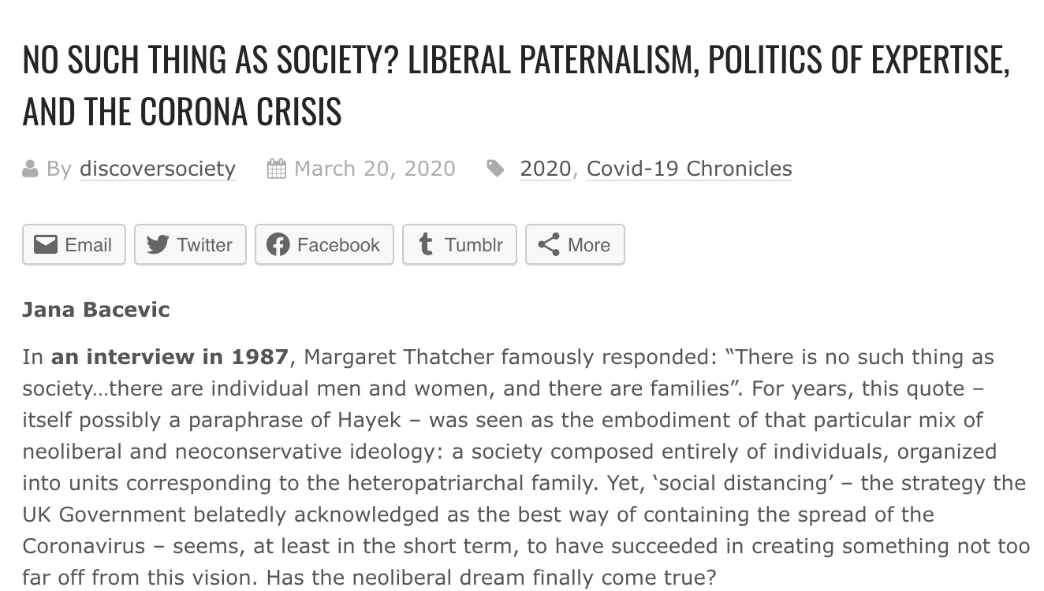
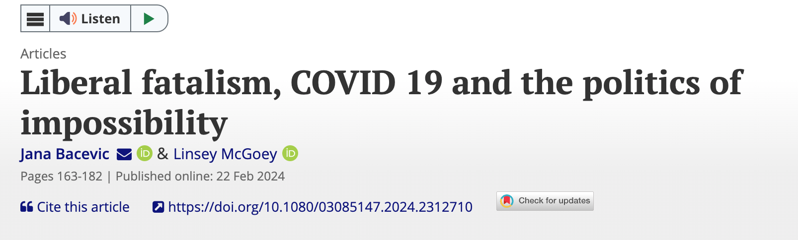
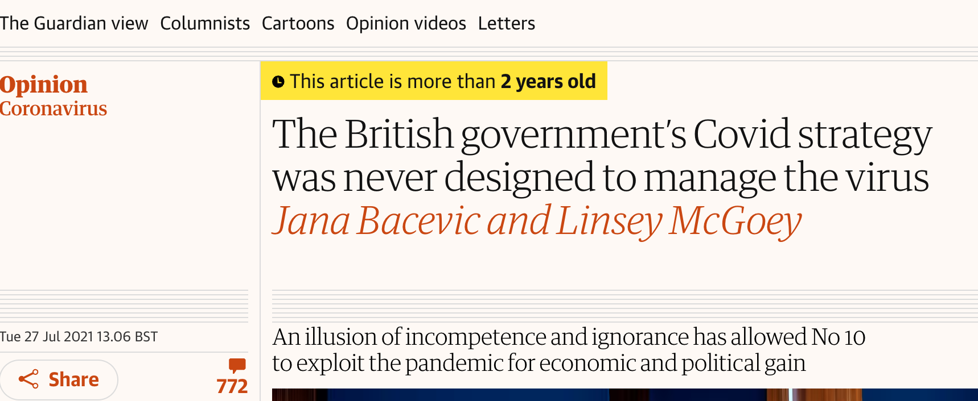
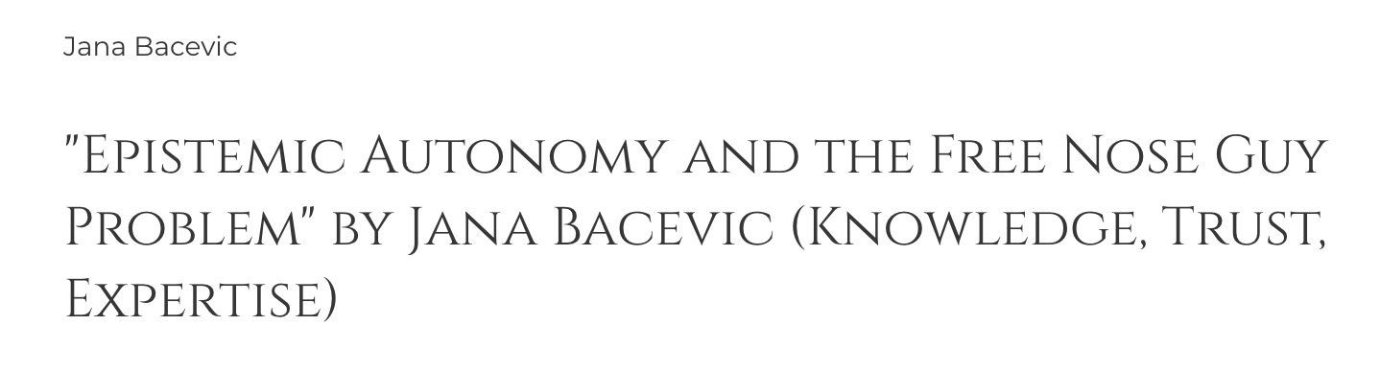
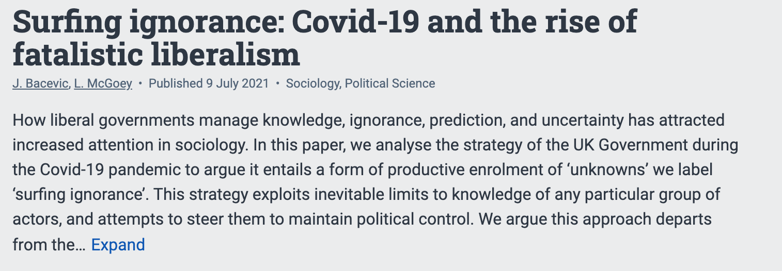
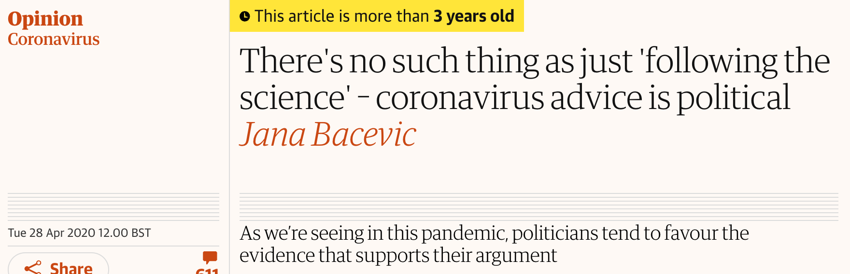
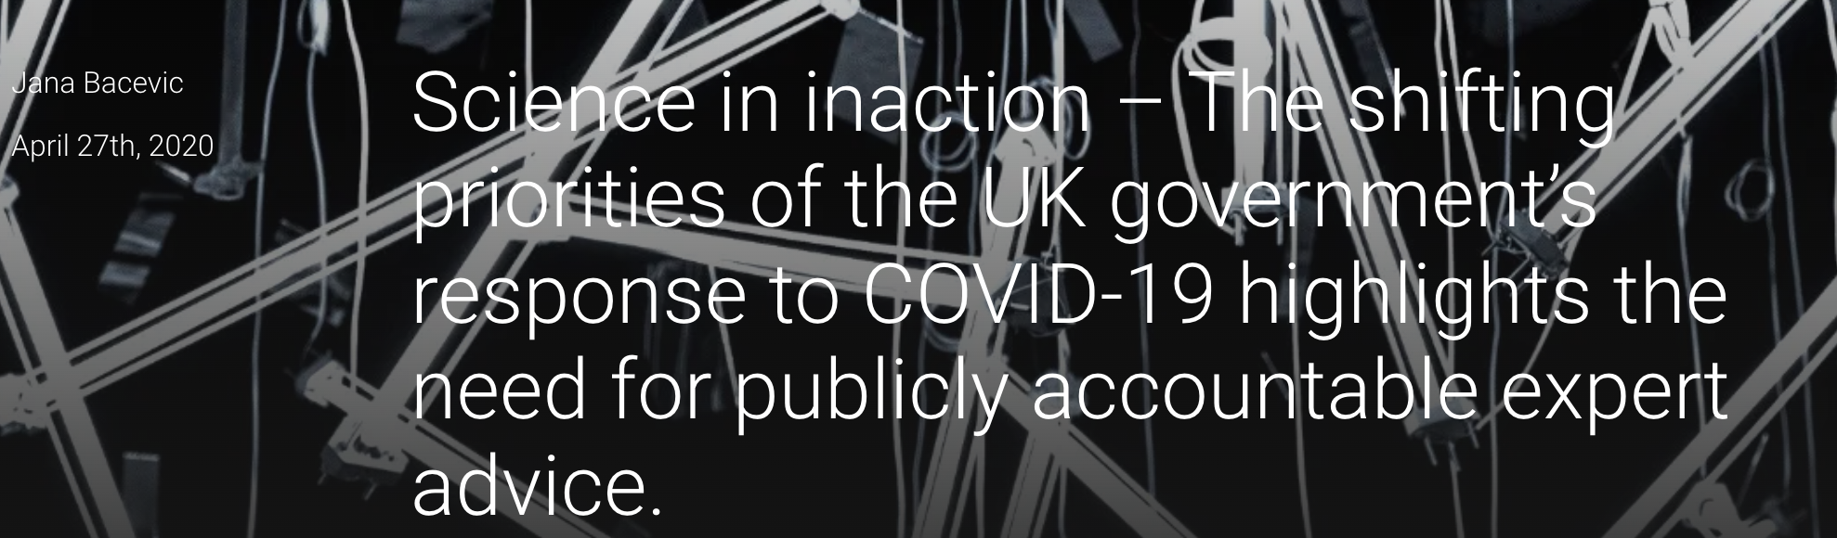
Bacevic & McGoey, 2024 [2020]; Bacevic, 2021a, b; Bacevic & McGoey, 2021; Bacevic 2020a, b, c, d

Slide 9
Why do political actors prefer not to know?
Ignorance as strategic; not just absence of knowledge (McGoey, 2019)
Avoidance of responsibility
Avoidance of accountability
Ability to govern (political control)
Political epistemology: politics + epistemology
(not “what did they know?” but “what did they ask?”)
Les acteurs politiques preferent “ne pas savoir” pour éviter la résponsabilité pour leurs actions; ou d’être rendus acontables pour l’absence d’action.

Slide 10
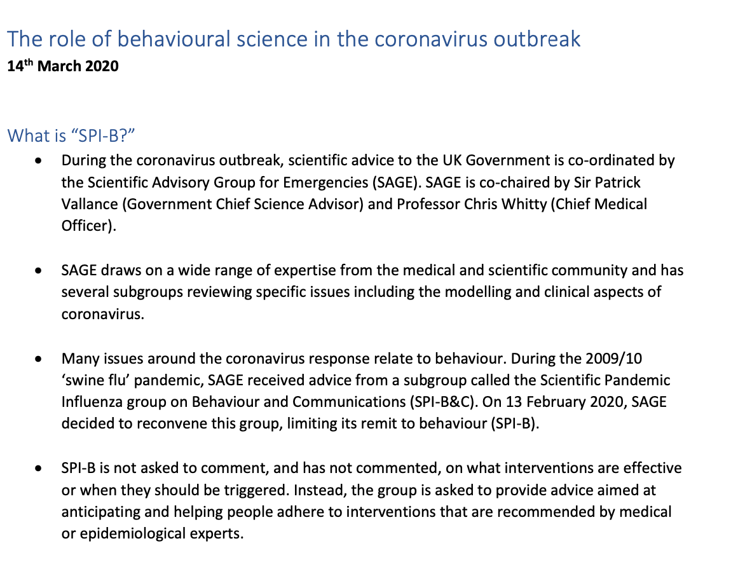
Scientific advice to the UK Government during Covid outbreak
SPI-M-O: mathematical modeling
SPI-B-O: behavioural and social interventions
Interventions (+ data bases) available on UK Government’s website
La groupe pour avis scientifiques de Gouvernement de Royaume-Uni pendant la pandémie (SAGE) était comprise d’experts en mathematique/modelling; interventions sociales; et épidemiologie.

Slide 11
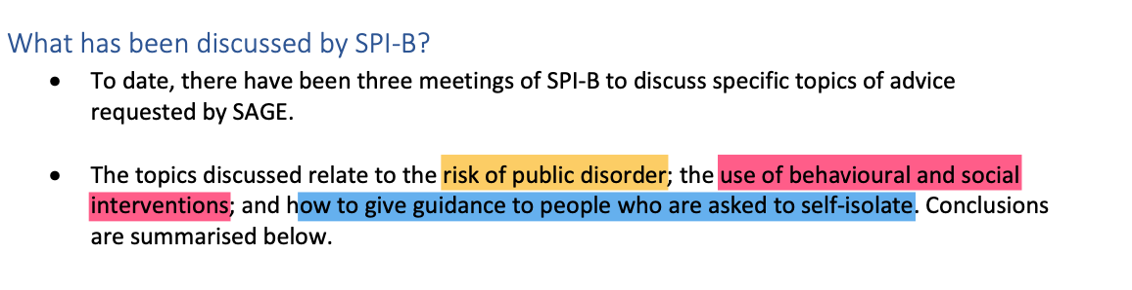
“Will they riot?”
SPI-B—07, 4 March 2020
Parmi les questions posés à SAGE, le premier était sur le risque de disordre public.

Slide 12
Risk of public disorder
“Large-scale rioting is unlikely. (...) Acts of altruism will likely predominate and the Government could promote and guide these.”
“Where public disorder occurs, it is usually triggered by perceptions about the Government’s response, rather than the nature of the epidemic per se. For example, a perception that the Government response strategies are not effective in looking after the public may lead to an increase in tensions”
(SPI-B-08, 25/02/2020)
Les experts de SAGE avaient répondu: le risque de desordre public depends de perceptions des mitigations introduises par de Gouvernment

Slide 13
Controlling the virus vs. controlling perceptions
“Expectations of how the Government will react will be set by media reports of public health strategies in other countries. This increases the risk of public concern if interventions that are perceived to be effective are not applied. A clear explanation as to why expected interventions are not being implemented may be necessary”
“SPI-B have divergent opinions on the impact of not applying widescale social isolation at the same time as recommending isolation to at-risk groups. One view is that explaining that members of the community are building some immunity will make this acceptable. Another view is that recommending isolation to only one section of society risks causing discontent.”
“Regardless of the decisions that are made, members of the public will have questions about all strategies listed in the table.”
SPI-B-04, 4/03/2020
De contrôler le virus à contrôler les perceptions

Slide 14
Knowledge x governance
Liberal meliorism (meliorisme libéral): the way to govern is to ensure people are empowered/ educated / equipped to make decisions
→ public education, information campaigns, public health
Neoliberal behaviourism: the way to govern is to outsource risk to markets, while not interfering (much) in the information available
→ privatization of education, digital health
Post-liberal fatalism: the way to govern is to constrain types of action (by retaining ambiguity about risks) whilst ensuring people cannot conceive of action outside of predefined choices

Slide 15
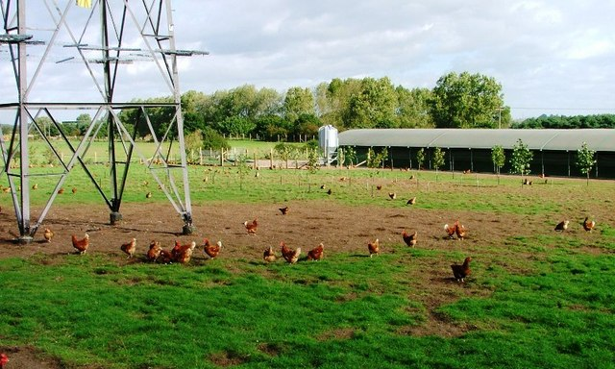
Free as a…free-range chicken?
Freedom from explicit constraint (direct intervention)
ensures control/’peace’
Predefined scope of action/choice (e.g., you can choose to wear or not wear a mask, but not to exist in a Covid-free public space)
→ ensures compliance and continuation of production
Normalization of exposure to harm

Slide 16

For a self-organized epistemology
Collectivization and de-institutionalization of scientific knowledge
Problem of sorting/quality control
But: knowing the risk?

Slide 17
Bacevic, J. & McGoey, L. (2024). Covid-19, liberal fatalism and the politics of impossibility. Economy and Society, 10.1080/03085147.2024.2312710
Bacevic, J (2021a). No such thing as sociological excuses? Performativity, rationality and social scientific expertise in late liberalism. European Journal of Social Theory, 24(3), 394–410. https://doi.org/10.1177/13684310211018939
Bacevic, J. (2021b). Epistemic Autonomy and the Free Nose Guy Problem, The Philosopher 109 (2), 36-42, https://www.thephilosopher1923.org/essay-bacevic
Bacevic, J. (2021c) Why we don’t act, The Boston Review, December 2021
Bacevic, J. (2020a). There’s no such thing as ‘following the science’: advice is political, The Guardian, 28 April 2020
Bacevic, J. (2020b). Science in inaction: The shifting priorities of the UK government’s response to COVID-19 highlights the need for publicly accountable expert advice, LSE Impact blog, 27 April 2020
Bacevic, J. (2020c). No such thing as society? Liberal paternalism, politics of expertise, and the Corona crisis, Discover Society, 20 March 2020
Bacevic, J. (2019). Knowing neoliberalism. Social Epistemology 33 (4), 380-392.
McGoey, L. (2019). The Unknowers: How Elite Ignorance Rules the World. London: Zed Books.

